Slide 1
Pre-Announcements
Justin: Alpha Kappa Psi Blockchain Event, next Wednesday in Chevron Auditorium
Companies like Oracle, Ripple, Coinbase, etc.
An overview of blockchains and its implications.
7 PM next Wednesday in iHouse.
Pizza, ice cream, and a raffle
Fliers up front if you want to do this thing.

Slide 2
Announcements
Midterm 2:
3/20, 8-10 PM in various rooms.
Covers material through 3/16 (this Friday).
Study using study guides.
THE KEY IS METACOGNITION: Reflect on your problem solving strategies and those of your fellow students.
Understanding a handful of solutions to old midterm problems is less helpful than you might think -- look at answers as late as possible.
There is an alternate 61C midterm from 6 - 8 in 1 LeConte.

Slide 3
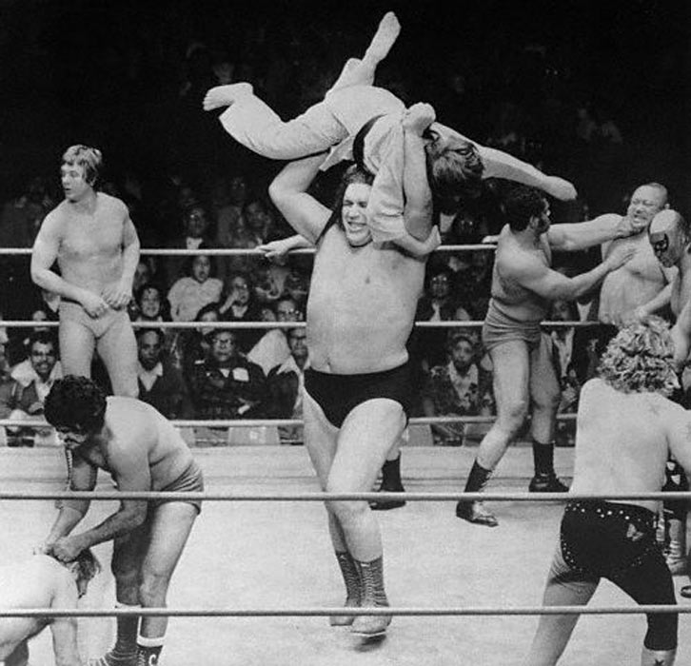
CS61B
Lecture 24: Priority Queues and Heaps
Priority Queues
Heaps
Tree Representations
Data Structures Summary

Slide 4
The Priority Queue Interface
/** (Min) Priority Queue: Allowing tracking and removal of the
* smallest item in a priority queue. */
public interface MinPQ<Item> {
/** Adds the item to the priority queue. */
public void add(Item x);
/** Returns the smallest item in the priority queue. */
public Item getSmallest();
/** Removes the smallest item from the priority queue. */
public Item removeSmallest();
/** Returns the size of the priority queue. */
public int size();
}
Useful if you want to keep track of the “smallest”, “largest”, “best” etc. seen so far.

Slide 5

Usage Example: Unharmonious Texts
Imagine that you’re part of Grand Leader’s Information Compliance and Happiness Enhancement (GLICHE) team.
Your job: Monitor the text messages of the citizens to make sure that they are not having any unharmonious conversations.
Each day, you prepare a report of the M messages that seem most unharmonious using the HarmoniousnessComparator.
Naive approach: Create a list of all messages sent for the entire day. Sort it using your comparator. Return the M messages that are largest.

Slide 6
Naive Implementation: Store and Sort
public List<String> unharmoniousTexts(Sniffer sniffer, int M) {
ArrayList<String> allMessages = new ArrayList<String>();
for (Timer timer = new Timer(); timer.hours() < 24; ) {
allMessages.add(sniffer.getNextMessage());
}
Comparator<String> cmptr = new HarmoniousnessComparator();
Collections.sort(allMessages, cmptr, Collections.reverseOrder());
return allMessages.sublist(0, M);
}
Potentially uses a huge amount of memory Θ(N), where N is number of texts.
Goal: Do this in Θ(M) memory using a MinPQ.
MinPQ<String> unharmoniousTexts = new HeapMinPQ<Transaction>(cmptr);

Slide 7
Better Implementation: Track the M Best
public List<String> unharmoniousTexts(Sniffer sniffer, int M) {
Comparator<String> cmptr = new HarmoniousnessComparator();
MinPQ<String> unharmoniousTexts = new HeapMinPQ<Transaction>(cmptr);
for (Timer timer = new Timer(); timer.hours() < 24; ) {
unharmoniousTexts.add(sniffer.getNextMessage());
if (unharmoniousTexts.size() > M)
{ unharmoniousTexts.removeSmallest(); }
}
ArrayList<String> textlist = new ArrayList<String>();
while (unharmoniousTexts.size() > 0) {
textlist.add(unharmoniousTexts.removeSmallest());
}
return textlist;
}
Can track top M transactions using only M memory. API for MinPQ also makes code very simple (don’t need to do explicit comparisons).

Slide 8
How Would We Implement a MinPQ?
Some possibilities:
Ordered Array
Bushy BST: Maintaining bushiness is annoying. Handling duplicate priorities is awkward.
HashTable: No good! Items go into random places.
 | Ordered Array | Bushy BST | Hash Table | Heap
add | Θ(N) | Θ(log N) | Θ(1)
getSmallest | Θ(1) | Θ(log N) | Θ(N)
removeSmallest | Θ(N) | Θ(log N) | Θ(N)
Caveats |  | Dups tough
Worst Case Θ(·) Runtimes

Slide 9
Heaps

Slide 10
Introducing the Heap
BSTs would work, but need to be kept bushy and duplicates are awkward.
Binary min-heap: Binary tree that is complete and obeys min-heap property.
Min-heap: Every node is less than or equal to both of its children.
Complete: Missing items only at the bottom level (if any), all nodes are as far left as possible.
0
0
0
0
0
5
1
5
1
5
1
5
1
8
8
6
2
8
8
6
8
8
2
8
4
6
Incomplete
Lacks min-heap property

Slide 11
Heap Comprehension Test: http://yellkey.com/present
How many of these are min heaps?
0
1
2
3
4
8
5
4
0
8
8
6
2
7
1
8
8
8
7
8
0
3
5
9

Slide 12
Heap Comprehension Test: http://yellkey.com/present
How many of these are min heaps?
0
1
2
3
4
8
5
4
0
8
8
6
2
7
1
8
8
8
7
8
0
3
5
9
Incomplete
Lacks min-heap property

Slide 13
What Good Are Heaps?
Heaps lend themselves very naturally to implementation of a priority queue.
Hopefully easy question:
How would you support getSmallest()?
0
5
1
8
8
6

Slide 14
How Do We Add To A Heap?
Challenge: Come up with an algorithm for add(x).
How would we insert 3?
Runtime must be logarithmic.
Bonus: Come up with an algorithm for removeSmallest().
Solution: See https://goo.gl/wBKdFQ for an animated demo.
1
5
1
6
5
6
3
7
7
8
?

Slide 15
Heap Operations Summary
Given a heap, how do we implement PQ operations?
getSmallest() - return the item in the root node.
add(x) - place the new employee in the last position, and promote as high as possible.
removeSmallest() - assassinate the president (of the company), promote the rightmost person in the company to president. Then demote repeatedly, always taking the ‘better’ successor.
See https://goo.gl/wBKdFQ for an animated demo.
Remaining question: How would we do all this in Java?

Slide 16
Tree Representations

Slide 17
How do we Represent a Tree in Java?
Approach 1a, 1b and 1c: Create mapping from node to children.
w
x
y
z
w
x
y
z
1a: Fixed-Width Nodes (BSTMap used this approach)
public class Tree1A<Key> {
Key k; // e.g. 0
Tree1A left;
Tree1A middle;
Tree1A right;
...

Slide 18
How do we Represent a Tree in Java?
Approach 1a, 1b and 1c: Create mapping from node to children.
w
x
y
z
public class Tree1B<Key> {
Key k; // e.g. 0
Tree1B[] children;
...
w
x
y
z
1b: Variable-Width Nodes

Slide 19
How do we Represent a Tree in Java?
Approach 1a, 1b and 1c: Create mapping from node to children.
w
public class Tree1C<Key> {
Key k; // e.g. 0
Tree1C favoredChild;
Tree1C sibling;
...
x
y
z
w
x
y
z
1c: Sibling Tree

Slide 20
How do we Represent a Tree in Java?
Approach 1a, 1b and 1c: Create mapping from node to children.
w
x
y
z
w
w
x
y
z
x
y
z
1a: Fixed-Width Nodes
1b: Variable-Width Nodes
w
x
y
z
1c: Sibling Tree

Slide 21
How do we Represent a Tree in Java?
Approach 2: Store keys in an array. Store parentIDs in an array.
Similar to what we did with disjointSets.
w
x
y
z
public class Tree2<Key> {
Key[] keys;
int[] parents;
...
Key[] keys
w
x
y
z
int[] parents
0
0
0
0
0 1 2 3
Key[] keys
0
k
k
e
v
b
g
p
y
a
d
f
j
m
r
x
1
2
0 1 2 3 4
5 6 7 8 9 10 11 12 13
e
v
3
4
5
6
int[] parents
b
g
p
y
7
0
0
0
1
1
2
2
3
3
4
4
5
5
6
a
d
f
j
m
r
x
8
9
10
11
12
13
0 1 2 3 4
5 6 7 8 9 10 11 12 13

Slide 22
How do we Represent a Tree in Java?
Approach 3: Store keys in an array. Don’t store structure anywhere.
To interpret array: Simply assume tree is complete.
Obviously only works for “complete” trees.
w
x
y
z
public class Tree3<Key> {
Key[] keys;
...
Key[] keys
w
x
y
z
0 1 2 3
Key[] keys
0
k
k
e
v
b
g
p
y
a
d
f
j
m
r
x
1
2
0 1 2 3 4
5 6 7 8 9 10 11 12 13
e
v
3
b
4
g
5
p
6
y
7
a
d
f
j
m
r
x
8
9
10
11
12
13

Slide 23
A Deep Look at Approach 3
Challenge: Write the parent(k) method for approach 3.
w
public void swim(int k) {
if (keys[parent(k)] ≻ keys[k]) {
swap(k, parent(k));
swim(parent(k));
}
}
x
y
z
Key[] keys
w
x
y
z
0 1 2 3
Key[] keys
0
k
k
e
v
b
g
p
y
a
d
f
j
m
r
x
1
2
0 1 2 3 4
5 6 7 8 9 10 11 12 13
e
v
3
4
5
6
public class Tree3<Key> {
Key[] keys;
...
b
g
p
y
7
a
d
f
j
m
r
x
8
9
10
11
12
13

Slide 24
A Deep Look at Approach 3
Challenge: Write the parent(k) method for approach 3.
w
public void swim(int k) {
if (keys[parent(k)] ≻ keys[k]) {
swap(k, parent(k));
swim(parent(k));
}
}
x
y
z
Key[] keys
w
x
y
z
0 1 2 3
public int parent(int k) {
return (k - 1) / 2;
}
Key[] keys
0
k
k
e
v
b
g
p
y
a
d
f
j
m
r
x
1
2
0 1 2 3 4
5 6 7 8 9 10 11 12 13
e
v
3
4
5
6
public class Tree3<Key> {
Key[] keys;
...
b
g
p
y
7
a
d
f
j
m
r
x
8
9
10
11
12
13

Slide 25
Tree Representations (Summary)
w
w
w
x
y
z
x
y
z
x
y
z
1a: Fixed Number of Links (One Per Child)
1b: Array of Child Links
w
Key[] keys
w
x
y
z
Key[] keys
int[] parents
w
x
y
z
x
y
z
0
0
0
0
0 1 2 3
3: Array of Keys
1c: FirstBorn/Sibling Links
2: Array of Keys, Array of Structure

Slide 26
Approach 3B (book implementation): Leaving One Empty Spot
Approach 3b: Store keys in an array. Offset everything by 1 spot.
Same as 3, but leave spot 0 empty.
Makes computation of children/parents “nicer”.
leftChild(k) = k*2
rightChild(k) = k*2 + 1
parent(k) = k/2
w
x
y
z
Key[] keys
-
w
x
y
z
0 1 2 3 4
Key[] keys
1
k
-
k
e
v
b
g
p
y
a
d
f
j
m
r
x
2
3
0 1 2 3 4
5 6 7 8 9 10 11 12 13 14
e
v
4
b
5
g
6
p
7
y
8
a
d
f
j
m
r
x
In next week’s lab, you’ll implement a MinPQ.
9
10
11
12
13
14

Slide 27
Heap Implementation of a Priority Queue
 | Ordered Array | Bushy BST | Hash Table | Heap
add | Θ(N) | Θ(log N) | Θ(1) | Θ(log N)
getSmallest | Θ(1) | Θ(log N) | Θ(N) | Θ(1)
removeSmallest | Θ(N) | Θ(log N) | Θ(N) | Θ(log N)
Notes:
Why “priority queue”? Can think of position in tree as its “priority.”
Heap is log N time AMORTIZED (some resizes, but no big deal).
BST can have constant getSmallest if you keep a pointer to smallest.
Heaps handle duplicate priorities much more naturally than BSTs.
Array based heaps take less memory (very roughly about 1/3rd the memory of representing a tree with approach 1a).
Items with same priority hard to handle.

Slide 28
Some Implementation Questions
How does a PQ know how to determine which item in a PQ is larger?
What could we change so that there is a default comparison?
What constructors are needed to allow for different orderings?
/** (Min) Priority Queue: Allowing tracking and removal of the
* smallest item in a priority queue. */
public interface MinPQ<Item> {
/** Adds the item to the priority queue. */
public void add(Item x);
/** Returns the smallest item in the priority queue. */
public Item getSmallest();
/** Removes the smallest item from the priority queue. */
public Item removeSmallest();
/** Returns the size of the priority queue. */
public int size();
}

Slide 29
Data Structures Summary

Slide 30
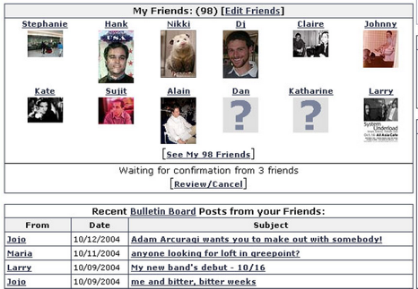
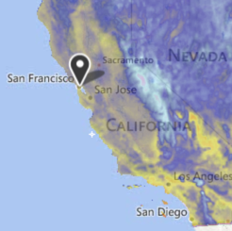
The Search Problem
Given a stream of data, retrieve information of interest.
Examples:
Website users post to personal page. Serve content only to friends.
Given logs for thousands of weather stations, display weather map for specified date and time.

Slide 31
Search Data Structures (The particularly abstract ones)
Name | Storage Operation(s) | Primary Retrieval Operation | Retrieve By:
List | add(key) insert(key, index) | get(index) | index
Map | put(key, value) | get(key) | key identity
Set | add(key) | containsKey(key) | key identity
PQ | add(key) | getSmallest() | key order (a.k.a. key size)
Disjoint Sets | connect(int1, int2) | isConnected(int1, int2) | two int values

Slide 32
Searching Data Structures:
Stack
PQ
Hash Table
Set
BST
Map
LLRB
2-3 Tree
List
DisjointSets
Notes:
Last semester’s in class development of this slide resulted in this: https://docs.google.com/presentation/d/1ewnsTvGmgMrtIy0OQqqmIn0dkjbgBD7JCBoeGXzLKx4/edit#slide=id.g46c32de42_00

Slide 33
Searching Data Structures:
Linked List
Stack
Resizing Arrays
Ordered Array
PQ
BST
LLRB
Set
2-3 Tree
Hash Table
LLRBs
Heap
Map
Linked List
Separate Chaining HT
List
Resizing Arrays
Linear Probing HT
DisjointSets
2017 version
Notes:
Last semester’s in class development of this slide resulted in this: https://docs.google.com/presentation/d/1ewnsTvGmgMrtIy0OQqqmIn0dkjbgBD7JCBoeGXzLKx4/edit#slide=id.g46c32de42_00

Slide 34
Searching Data Structures:
Stack
Heap
Balanced Tree
Chaining HT
Ordered Linked List
Linear Probing HT
PQ
Chaining HT (lacks order, very odd)
Set
LinkedList
Resizing Array
Map
LinkedList
List
BST (Vanilla)
Resizing Array
Red Black
Quick Find
B-Trees (2-3 / 2-3-4)
Quick Union
DisjointSets
Heap
Weighted QU
2016 version
WQUPC
Notes:
Last semester’s in class development of this slide resulted in this: https://docs.google.com/presentation/d/1ewnsTvGmgMrtIy0OQqqmIn0dkjbgBD7JCBoeGXzLKx4/edit#slide=id.g46c32de42_00

Slide 35
Abstraction often happens in layers!
PQ
Heap Ordered Tree
External Chaining HT
Array of Buckets
Approach 1A
ArrayList
Approach 1B
Bucket
Resizing Array
Tree
Approach 1C
LinkedList
Approach 2
BST (requires comparable items)
Approach 3
ArrayMap (lab 9)
Approach 3B

Slide 36
Specialized Searching Data Structures:
Stack
Linked List
List
Queue
Resizing Array (slightly suboptimal due to resizing)
Deque
In Java:
java.util.SortedSet
java.util.SortedMap
Set
Sorted Set
BST
2-3 Tree
Map
Sorted Map
RedBlack
Don’t usually consider MinPQ and MaxPQ to be different data structures, since we can just provide the opposite comparator.
PQ

Slide 37
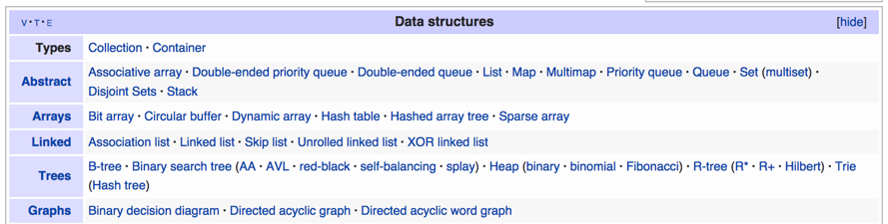
Data Structures
Data Structure: A particular way of organizing data.
We’ve covered many of the most fundamental abstract data types, their common implementations, and the tradeoffs thereof.
We’ll do two more in this class:
The quadtree (Friday).
The graph (starting after exam).

Slide 38
Citations
Title slide Andre the Giant picture: Unknown source
Friendster screenshot: http://jeremy.zawodny.com/i/friendster_rss.jpg
Weather screenshot: weather.com

